Slide 1




Beijing University of Posts and Telecommunications
Privacy as a Resource
in Differentially Private Federated Learning
Jinliang Yuan¹, Shangguang Wang¹, Shihe Wang¹, Yuanchun Li², Xiao Ma¹, Ao Zhou¹ and Mengwei Xu¹
¹Beijing University of Posts and Telecommunications, China
²Tsinghua University, China
Notes:
Good morning, everyone. I am glad to have the opportunity to make this presentation.
Today’s topic is Privacy as a Resource in Differentially Private Federated Learning.
This work was done by me and my collaborators at Beijing University of Posts and Telecommunications and Tsinghua University.

Slide 2
Privacy as a Resource
in Differentially Private Federated Learning
Beijing University of Posts and Telecommunications
Motivation
Design
Evaluation
Notes:
Next, I will spent about 12 minutes introducing our work in following three steps.

Slide 3



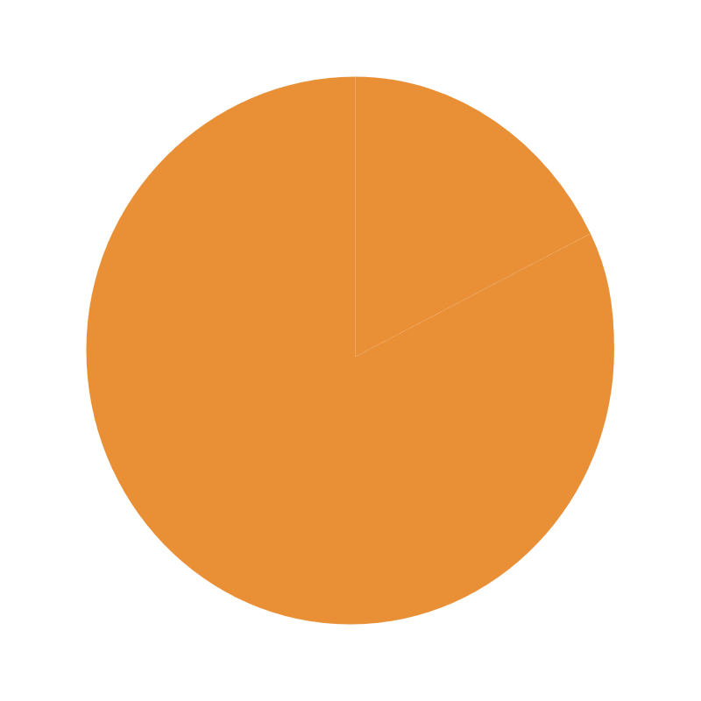


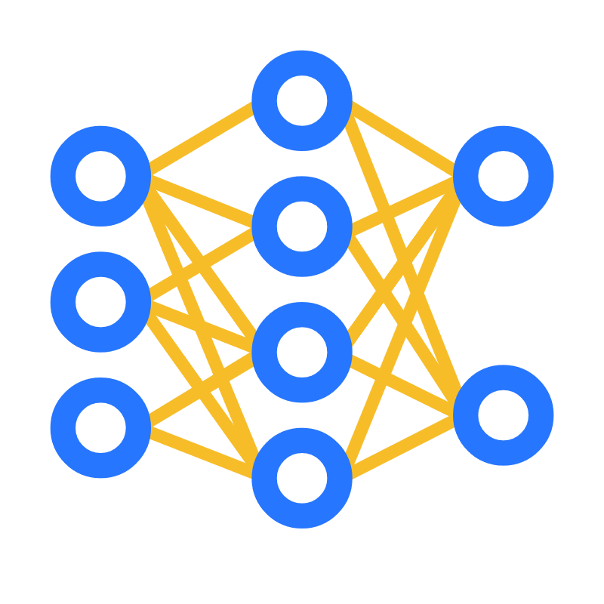
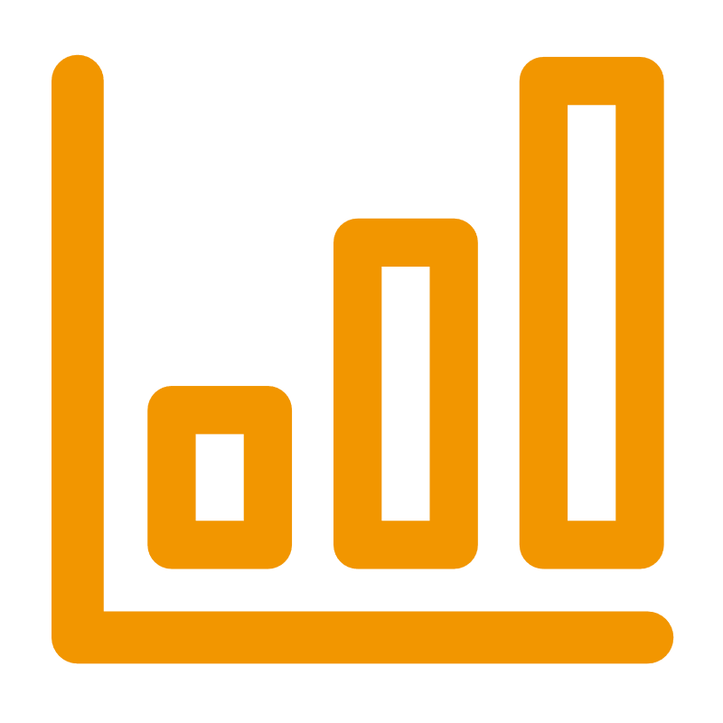









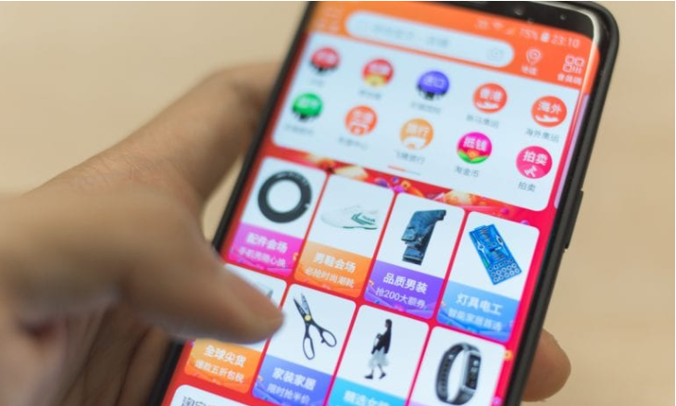








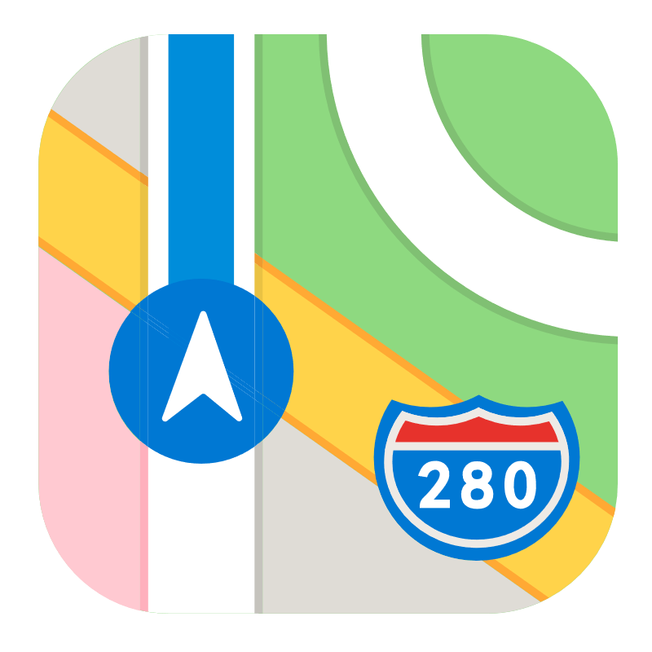



Privacy Leakage in Data-driven Mobile Applications
Intelligence and Analytics
2018
Facebook exposed 87 million user data
Data collection APP
2019
Capital one bank leaked 106 million
2020
Microsoft exposed 250 million records
Private user data
2021
Alibaba leaked 1.2 billion records
2022
Cash app exposed 8 million records
Centralized data intelligence system
Serious privacy leakage on user sensitive data
Notes:
First, we show why privacy protection is important in current data-driven mobile applications. At present, most APP manufacturers, like google, facebook, and tiktok, generally collect user data through their APPs to centralized cloud, and then use it for extensive Intelligence and Analytics.
But this approach has also led to increasingly terrible privacy leakage. As shown in the right picture, such incidents have occurred frequently in the past five years, resulting in huge economic losses, up to several billion dollors.

Slide 4




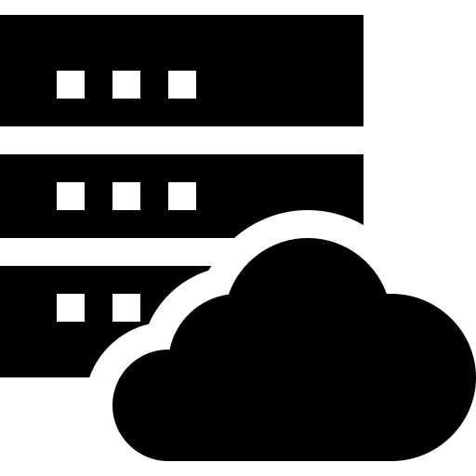
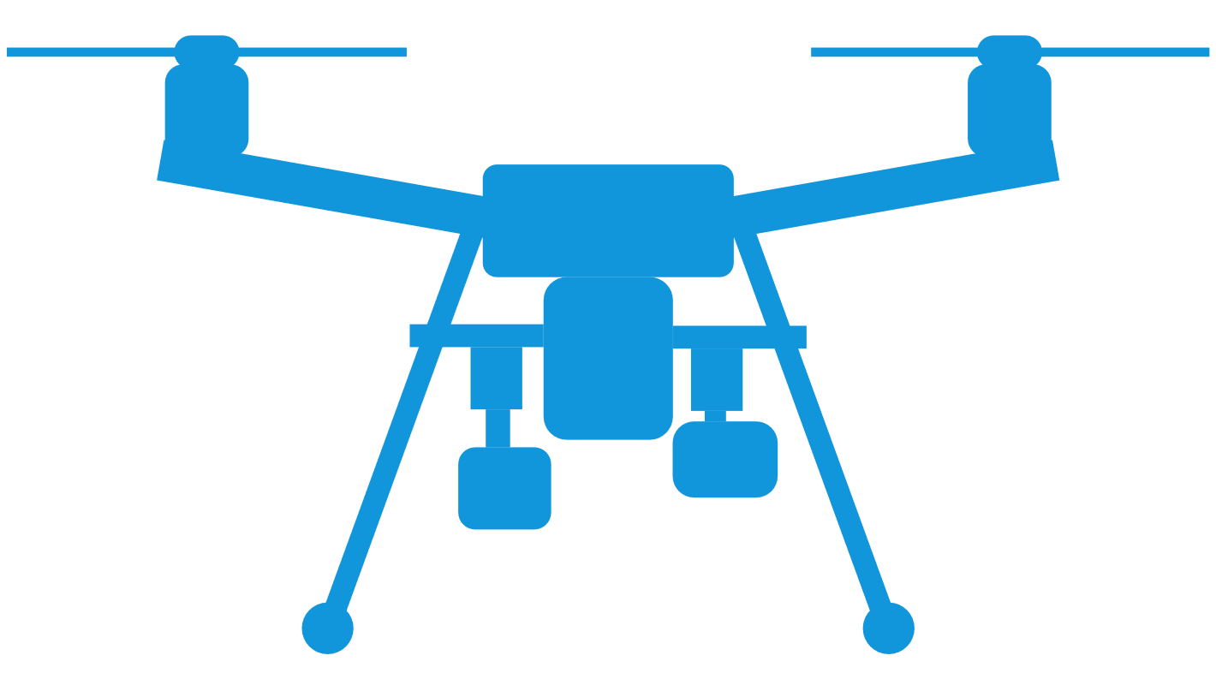
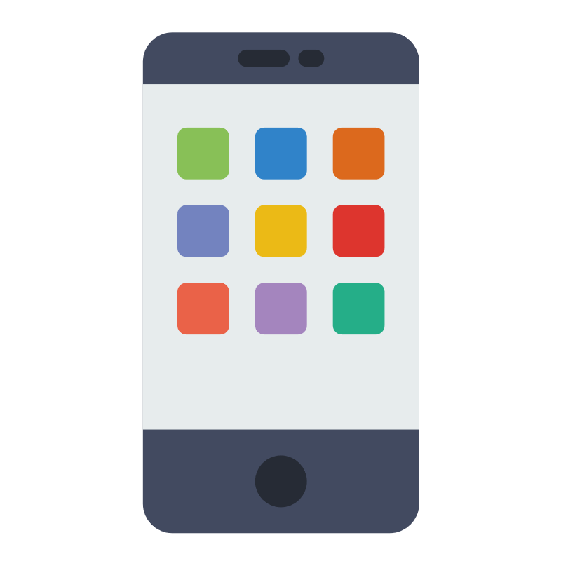
Federated Learning to Enhance Data Privacy
Cross-device Federated Learning System
Cons???
Main workflow:
Keep sensitive data on device
On-device model training
Model transmission through network
Model aggregation on cloud
Sensitive data
Model parameters
Cloud
Network transmission
Pros: Decentralized data storage and model
training, instead of a centralized way
Edge device
Notes:
Federated Learning is currently considered the key technology to address such privacy leakage. Its main workflow is: and ….
Its key strength is:
But does that mean it is the perfect privacy solution.

Slide 5
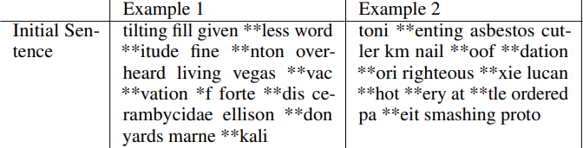
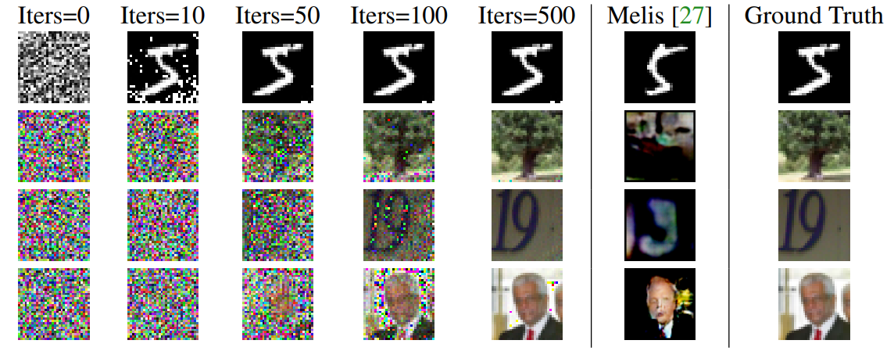
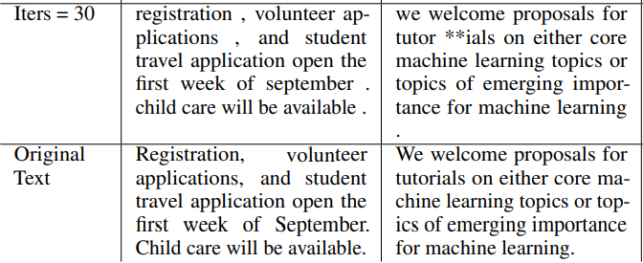
Deep Leakage From Gradients
Nearly the same
(1) computer vision (2) natural language processing
Contribution: It is possible to obtain the private training data from the publicly shared gradients, which means the raw model transmission through network in FL is not safe.
Reference: Deep leakage from gradients; Advances in neural information processing systems; Massachusetts Institute of Technology; 2019
Notes:
The answer is NO. Because research shows that the gradients in ML training can also leak original training data. This kind of leakage happens on both CV and NLP tasks. For example in CV, during the training iteration process, the image was inferred based on gradient, and the picture clarity and accuracy of the inferred image gradually approached the original training data at the final column: ground truth .
Its main contribution is to demonstrate that:

Slide 6
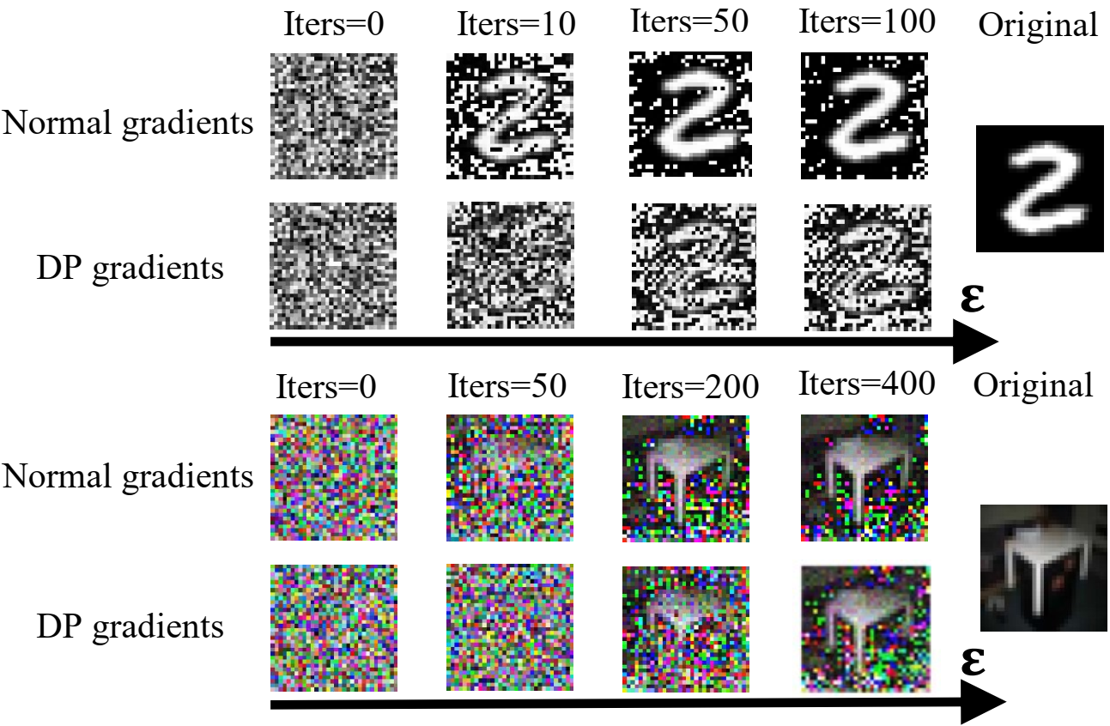
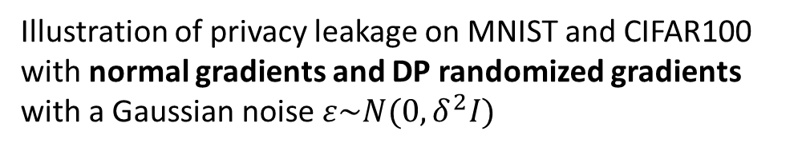
Differential Privacy to Protect Gradient Exchange
Illustration of privacy leakage on MNIST and CIFAR100 with normal gradients and DP randomized gradients with a Gaussian noise $ε\sim N(0,δ^{2}I)$
1× more rounds
DP is the most popular and effective solution, currently [refs]
Ref #1: Learning differentially private recurrent language models; ICLR-18; Google
Ref #2: Privacy accounting and quality control in the sage differentially private ML platform; SOSP; Columbia University
Ref #3: FLAME: differentially private federated learning in the shuffle model; IJCAI-21; Renmin University of China
Ref #4: LDP-FL: practical private aggregation in federated learning with local differential privacy; IJCAI-21; Lehigh University
Ref #5: Renyi differential privacy of the subsampled shuffle model in distributed learning; NeurIPS-21; University of California
Notes:
Using differential privacy to disturb the gradient distribution can provide effective protection against such leakage. By comparing the DP randomized gradients and normal gradients, we can find that, for CIFAR100 data set, the shape of the table was already clear after 200 rounds of the scheme without DP, while the scheme with DP needed 400 rounds of training to see the table clearly. In other words, DP makes it twice as hard to attack the raw data.
Moreover, extensive studies have shown that:

Slide 7

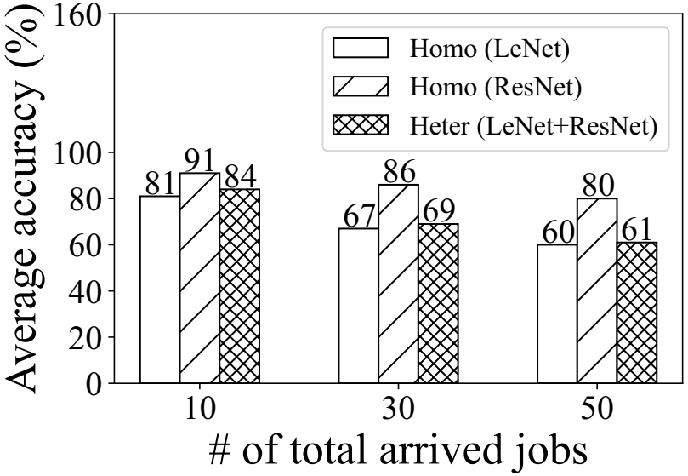
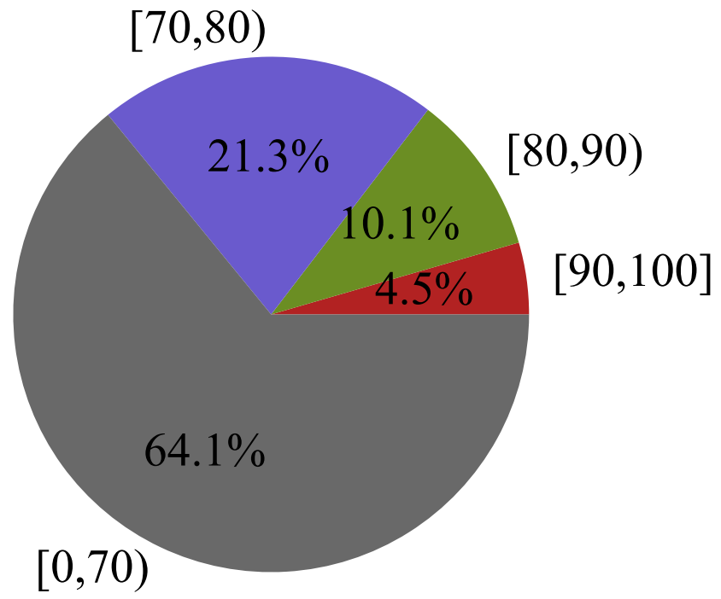
Challenges of Differentially Private FL System
System or platform perspective
Although differential privacy technology performs well on a single FL task, it causes serious performance degradation in more practical scenario with multiple submitted FL jobs.
23%↓
(a) Average accuracy of allocated jobs decreased significantly (23%↓) as the number of jobs increased.
(b) Only a very small number of jobs (14.6%) obtained acceptable model accuracy (e.g., ≥ 80%), and most jobs’ accuracy is too low (e.g., < 70%).
Notes:
In this article, we focus on the challenges of such differentially private FL system. Although differential privacy performs well on a single FL task, from a system and platform perspective, it should serve more tasks with the same batch of user data. Through extensive preliminary experiments, we found that it causes serious performance degradation in more practical scenario with multiple submitted FL jobs.
Specifically, we show two aspects of performance loss as below: 1, 2,

Slide 8
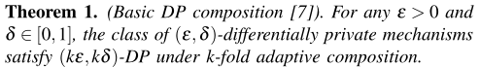
Underlying Rationales
(b) More jobs, more budget
(a) Trade-off between privacy budget and model accuracy
Notes:
We also analyzed the high-level underlying rationales behind these phenomena. On the one hand, there is a complex trade-off between the privacy budget and the model accuracy; on the other hand, multiple jobs consume privacy budget too fast.

Slide 9
Goals
Our goal is to develop a unified differentially private FL platform that coordinates dynamically arrived FL jobs with sensitive user data streams. The platform aims to enforce a global (ε,δ)-DP guarantee across participating devices to control the leakage of user information.
To improve the utility of sensitive user data, it focuses on how to schedule the global privacy budget to deliver more completed jobs and reduce SLO violation rate.
In short, how to serve more FL jobs with tight privacy budget?
Notes:
Therefore, our motivation in this paper is to design an efficient differentially private FL platform that could serve more FL tasks within a tight privacy budget.

Slide 10
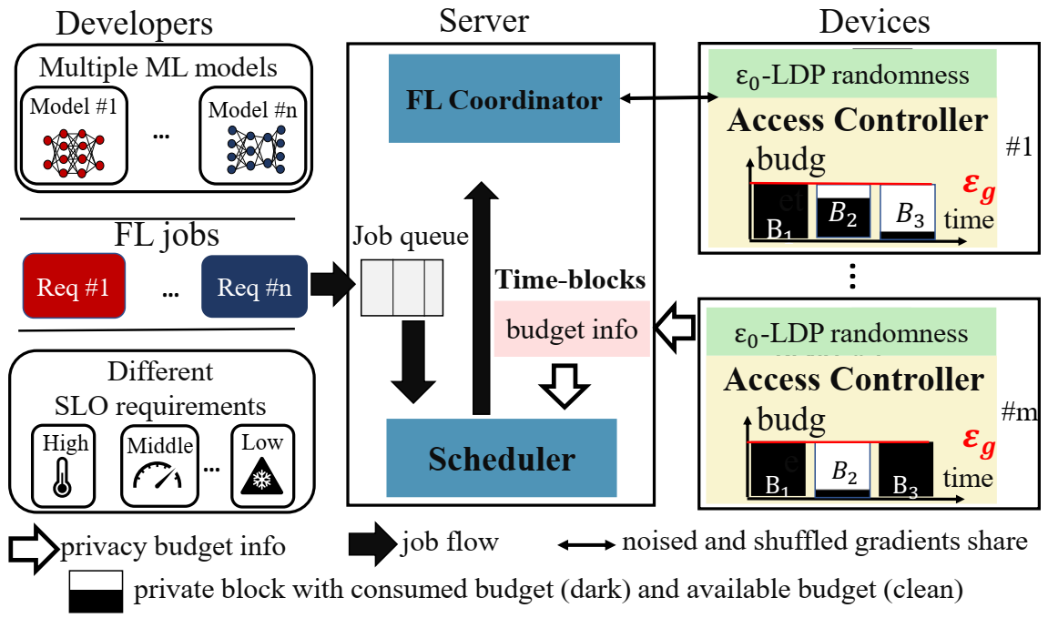
FLScheduler: Privacy as a Resource
Overview of our differentially private FL platform
Design Overview
Enable “endless” privacy budget consumption as time goes by
spilt data stream to time-frame blocks
time-blocks composition theorem
Support fine-grained privacy budget scheduling
AaR algorithm to reduce SLO violation rate
Best-effort to serve more complete jobs
Notes:
The next part shows the system design of our platform, namely FLScheduler. The core idea of the platform is to treat the DP budget into a system resource such as memory storage and network resource. There are two key contributions 1) it enables “endless” privacy budget consumption as time goes by 2) it supports fine-grained privacy budget scheduling. Below is the overall workflow of this platform.

Slide 11



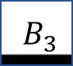
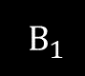
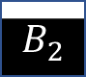
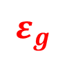
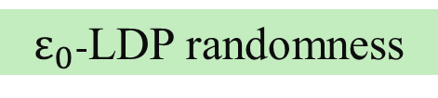
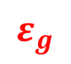
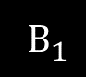
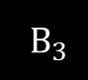
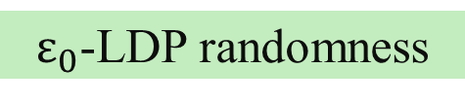
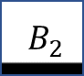
FLScheduler: Privacy as a Resource
Developers
Server
Devices
Multiple ML models
FL Coordinator
$ε_{0}$-LDP randomness
Device # 1
ML model #1
ML model #n
Access Controller
…
budget
#1
$$ε_{g}$$
$B_{1}$
$$B_{2}$$
$${ B}_{3}$$
time
FL jobs
Job queue
Req #1
…
Req #n
Time-blocks
…
budget info
$ε_{0}$-LDP randomness
Different
SLO requirements
Device # 1
Access Controller
budge
#m
High
Middle
Low
Scheduler
$$ε_{g}$$
…
$B_{1}$
$${ B}_{2}$$
$B_{3}$
time
Notes:
The platform is primarily divided into three components: FL model developers, servers, and mobile devices that voluntarily participate in FL. The developers are responsible for submitting FL jobs to the platform, which include the machine learning models to be trained and the corresponding service quality objectives, such as a desired model accuracy.

Slide 12
FLScheduler: Privacy as a Resource
Developers
Server
Devices
Multiple ML models
FL Coordinator
$ε_{0}$-LDP randomness
Device # 1
ML model #1
ML model #n
Access Controller
…
budget
#1
$$ε_{g}$$
$B_{1}$
$$B_{2}$$
$${ B}_{3}$$
time
FL jobs
Job queue
Req #1
…
Req #n
Time-blocks
…
budget info
$ε_{0}$-LDP randomness
Different
SLO requirements
Device # 1
Access Controller
budge
#m
High
Middle
Low
Scheduler
$$ε_{g}$$
…
$B_{1}$
$${ B}_{2}$$
$B_{3}$
time
private block with consumed budget (dark) and available budget (clean)
Notes:
The device side is primarily responsible for data access control and DP-based local training. The former splits the data stream into independent blocks based on time, where users can allocate their own privacy budgets for each block. The latter performs local updates based on the selected private data blocks.

Slide 13
FLScheduler: Privacy as a Resource
Developers
Server
Devices
Multiple ML models
FL Coordinator
$ε_{0}$-LDP randomness
Device # 1
ML model #1
ML model #n
Access Controller
…
budget
#1
$$ε_{g}$$
$B_{1}$
$$B_{2}$$
$${ B}_{3}$$
time
FL jobs
Job queue
Req #1
…
Req #n
Time-blocks
…
budget info
$ε_{0}$-LDP randomness
Different
SLO requirements
Device # 1
Access Controller
budge
#m
High
Middle
Low
Scheduler
$$ε_{g}$$
…
$B_{1}$
$${ B}_{2}$$
$B_{3}$
time
Notes:
The critical scheduling module, located on the server, plays a crucial role in carefully orchestrating the submitted FL tasks and the distribution of private data blocks across devices. Due to the unique nature of these non-replenishable privacy resources, scheduling them requires a different approach than traditional computational resources. Therefore, we propose a novel privacy budget scheduling algorithm that performs fine-grained scheduling on these blocks to achieve our objectives.

Slide 14
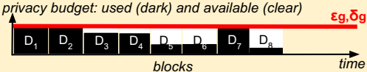
Time-blocks Composition Theorem
DP mechanism accounts for privacy loss at the granularity of whole data streams, which leads to a critical challenge in FL: running out of privacy budget quickly
Unused data points suffer the same privacy loss as the samples data points on each device.
Unused devices suffer the same privacy loss as the sampled devices during FL training.
Newly-generated data over time suffers the same privacy loss as the used data.
Sage proposed a new privacy accounting method on the split data block, namely block composition theorem, in a centralized ML platform. Address #1 and #3.
Reference: Privacy accounting and quality control in the sage differentially private ML platform; SOSP-19; Columbia University
Notes:
A core challenge in the system design is how to prevent fast consumption of privacy budgets in multi-job training due to the coarse-grained privacy accounting on the whole data stream. Specifically:
Previous work proposed to partition data stream into temporal blocks and introduced the block composition theorem to enable separate privacy accounting on each block, which can cover the #1 and #3 setting.

Slide 15
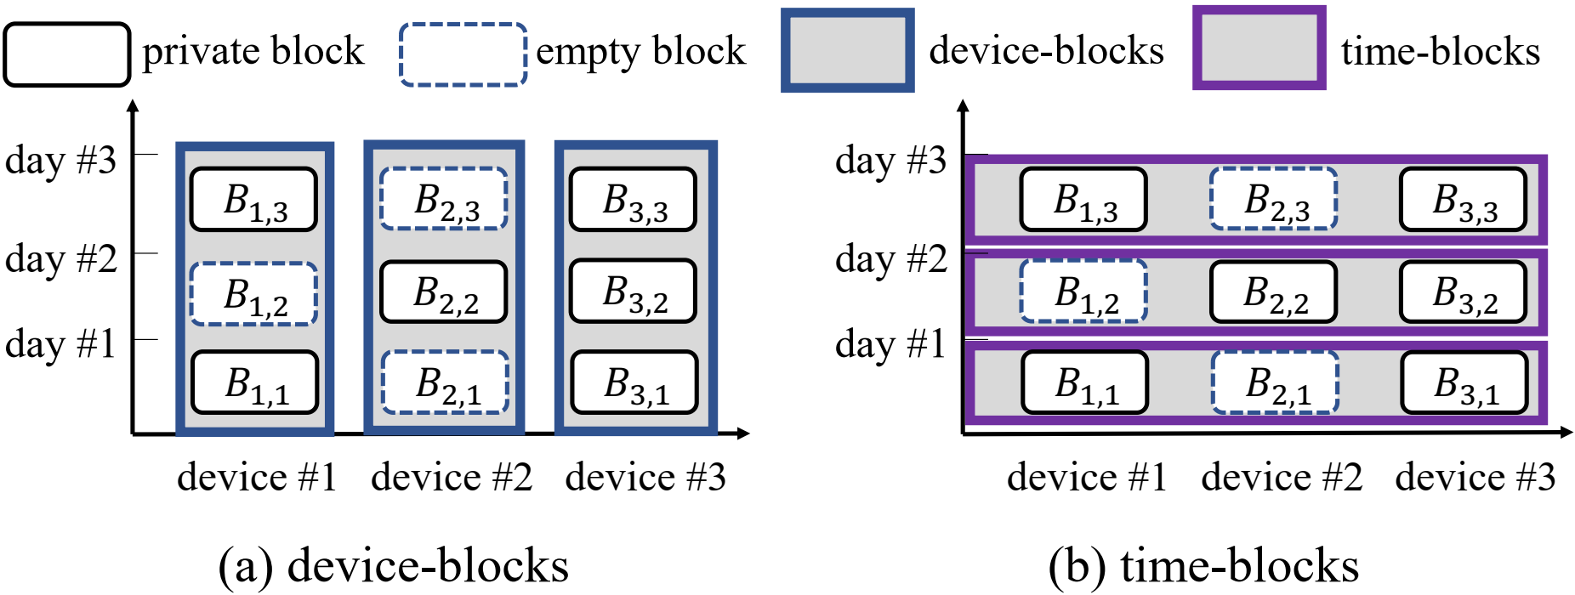
Time-blocks Composition Theorem
However, the centralized block composition can not account for the privacy loss on blocks across distributed devices, because the SOTA DP mechanism in FL accounts for privacy loss at the granularity of whole data streams across all devices.
Unused data points suffer the same privacy loss as the samples data points on each device.
Unused devices suffer the same privacy loss as the sampled devices during FL training.
Newly-generated data over time suffers the same privacy loss as the used data.
Time-blocks Composition Theorem
Privacy accounting at the granularity
of time-blocks when running multiple FL jobs with different SOTA DP mechanisms.
Notes:
The above solution does not effectively address the second challenge, which is the privacy consumption of data blocks across devices.
Our proposed solution is to organize the data blocks sliced by time on each device into a block collection called “time-blocks” in figure b. In this design, we should first determine which specific data from those days will be used for local model updates. We then extend the block composition theorem in centralized ML to Time-blocks Composition Theorem in distributed FL, which enable privacy accounting on the time-blocks across devices.

Slide 16
Two-stage Privacy Budget Scheduling
Our goal is carefully scheduling such a scarce resource to maximize the number of complete
jobs while reducing the SLO violation rate. However, it is substantially differs from traditional resource scheduling, like CPU cycles, memory……
Privacy is a non-replenishable resource.
All-or-nothing principle.
Budget requirements changing with FL’s uncertain block/device selection
Dominant Private Block Fairness, DPF [ref]
DPF’s key idea is twofold:
(1) unlock privacy budget for each block progressively, so the budget remains for the future;
(2) follow DRF’s max-min fairness design to allocate these blocks fairly among different jobs.
Reference: Privacy budget scheduling; OSDI-21; Columbia University
Notes:
In addition, how to serve more jobs while ensuring SLO for each job remains challenging. This is primarily due to the significant differences between privacy resource and traditional system resources.1xxx, which means once the consumed budget reaches the enforced global privacy budget, the corresponding time-blocks can never be used for training anymore. 2xxx, which means each FL job is either allocated with enough privacy budget to satisfy the SLO requirement, or no budget at all. 3xxx,
The previous algorithm for centrally scheduling privacy budgets in centralized ML tasks, called DPF considered the first two challenges. Its core idea consists of two aspects: 1xxx 2xxx

Slide 17
Two-stage Privacy Budget Scheduling
However, DPF assumes a prior and fixed privacy budget consumption for each job, which is not appropriate in cross-device FL scenario.
Privacy is a non-replenishable resource.
All-or-nothing principle.
Budget requirements changing with FL’s uncertain block/device selection.
Fixed and prior requirements of block vs. Iteration-level dynamic block/device selection
Block
allocation
Block
allocation
Job
vs.
Job
DPF in ML
Ours in FL
Iterations from #1 to #3
Iter-1
Iter-2
Iter-3
Notes:
DPF can not address the third challenge, due to its assumption of fixed privacy consumption. FL is naturally integrated with client/data block sampling. However, the concrete sampling strategy is often determined on demand (i,e, ahead of each global round) because the device can drop in/out from time to time.
We compare the block selection of DPF in centralized ML and ours in FL. DPF allocates private blocks for the entire training process in a centralized manner. On the other hand, our algorithm focuses on making iteration-level block allocation decisions, taking into account the specific device selection of FL job.

Slide 18
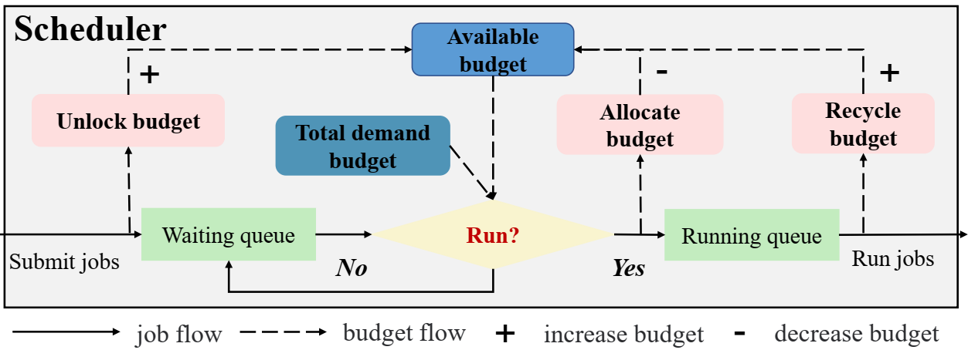
Two-stage Privacy Budget Scheduling
Our solution: Allocation and Recycle (AaR)
Key idea consists of two core stages: (1) a pre-allocation of an estimated upper-bound privacy budget at each FL job arrival; (2) and a progressive recycling of the un-consumed privacy budget during FL training.
Notes:
Our solution is a two-stage dynamic privacy budget scheduling, namely Allocation and Recycle. Its key idea consists of two core stages: 1xxx, 2xxx.

Slide 19
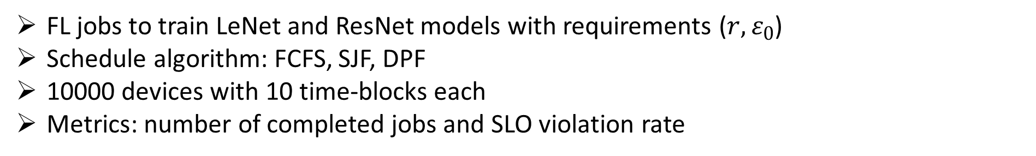
Evaluation
Experiment Settings
Simulation platform atop FedML integrated with 4 major functional modules:
LDP-based FL training
block-related data preprocessing
block-related privacy accounting
job scheduler
https://github.com/UbiquitousLearning/FLScheduler
FL jobs to train LeNet and ResNet models with requirements ($r,ε_{0}$)
Schedule algorithm: FCFS, SJF, DPF
10000 devices with 10 time-blocks each
Metrics: number of completed jobs and SLO violation rate
Notes:
Lastly, we present the performance results from our experimental evaluation. We first develop a simulation platform of our designed FLScheduler atop open-source FL platform integrated with 4 major functional modules. We also open source our new platform on Github. And other settings as below.

Slide 20
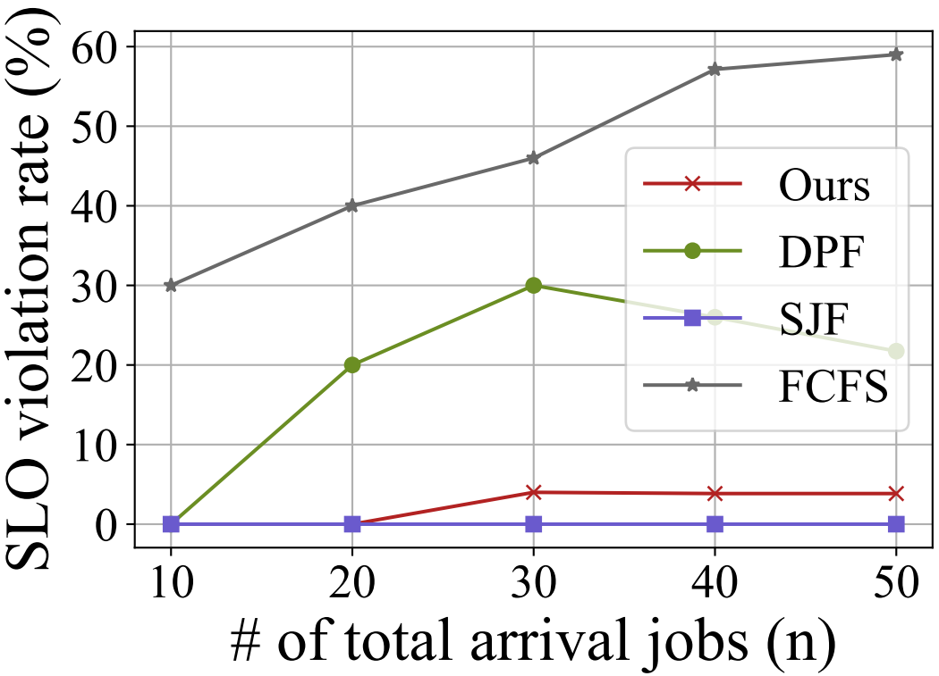
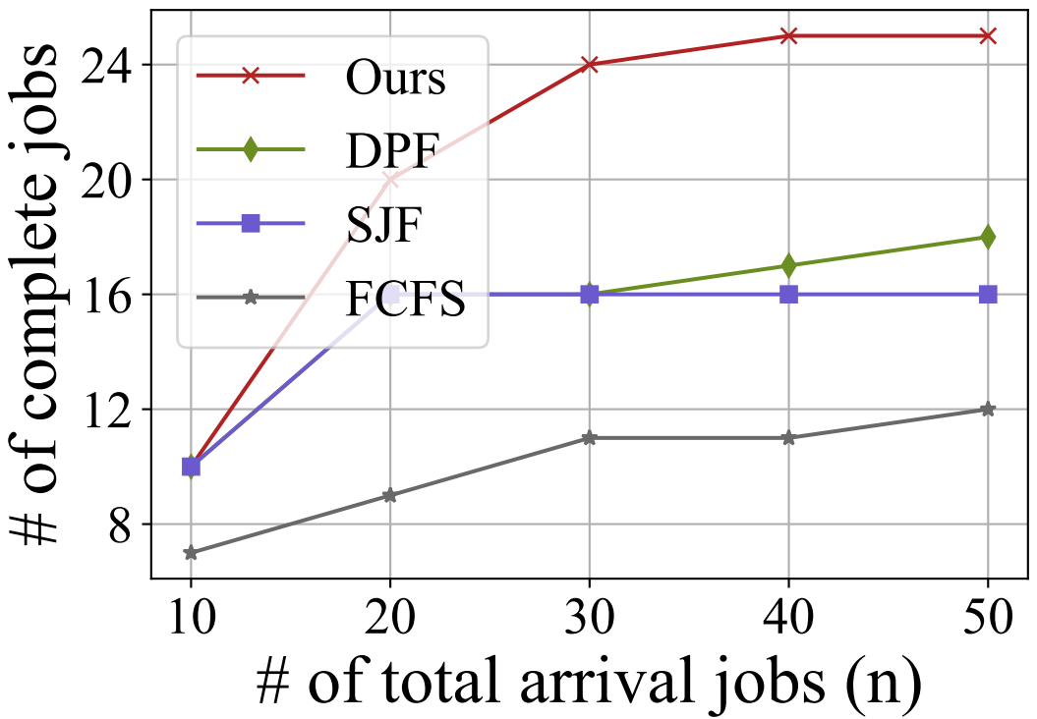
Evaluation
End-to-end performance
(a) Increase complete jobs (2×)
(b) Reduce violation rate (55%)
Our algorithm achieves more complete jobs with a lower violation rate.
Notes:
We first show our end-to-end performance on the number of complete jobs and SLO violation rate. Our algorithm shows a significant improvement compared to the baseline, with a doubled job completion count and a 55% reduction of SLO violation rate.

Slide 21
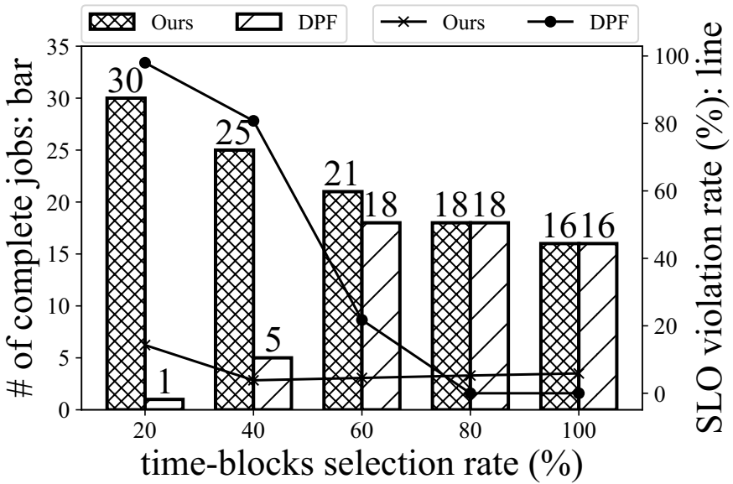
Evaluation
Sensitivity analysis: Impact of Time-blocks Selection Rate
(1) Trade-off between the two metrics:
higher bar and lower line
Fewer selected time-blocks attributes more complete jobs with lower violation rate
Rationale: ours fine-grained block sampling strategy allows the model to be trained by more samples at a lower expense of privacy budget.
Notes:
The second part of the evaluation focuses on the time block selection rate. The core of our algorithm lies in improving the utilization of privacy budgets by replacing the usage of the entire data stream with more fine-grained block selection. Our algorithm demonstrates a better trade-off between job completion count and SLO violation rate. It proves that supporting more fine-grained block selection indeed enhances system performance, as it incurs a lower privacy cost.

Slide 22
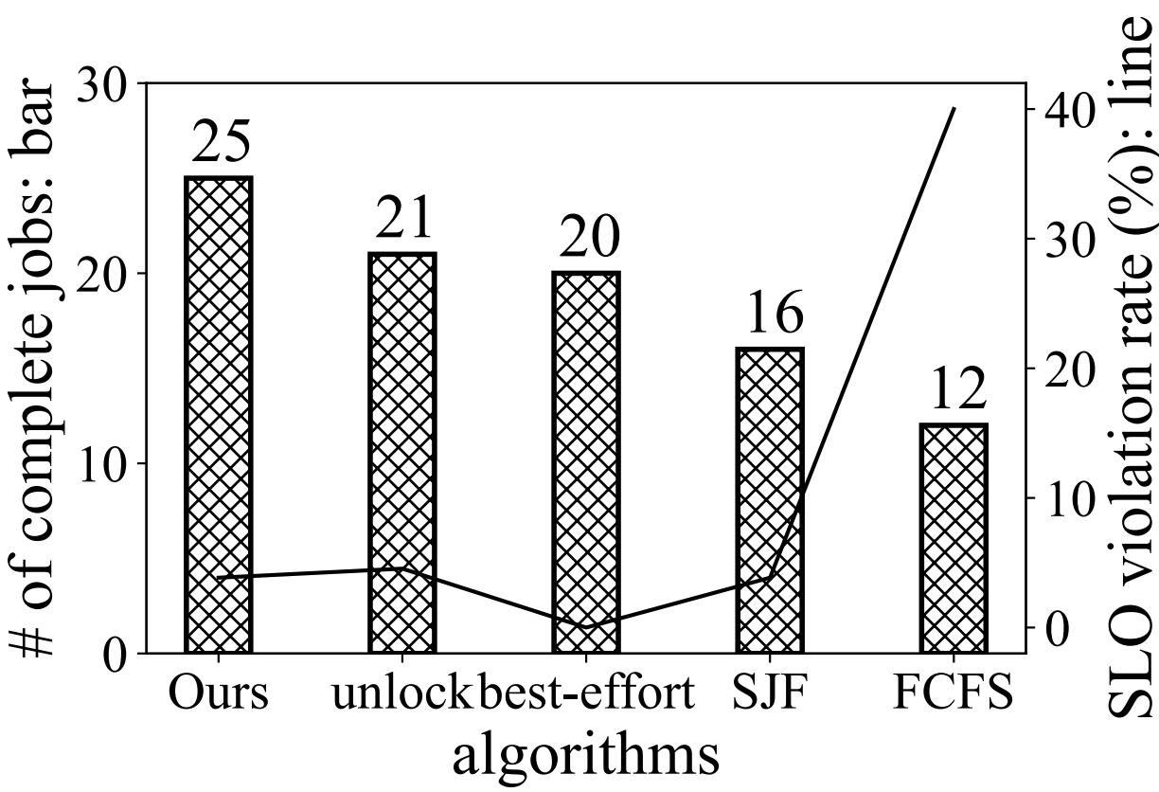
Evaluation
Ablation Results: AaR’s unlock and best-effort design
They both outperform SJF and FCFS
But, 20% and 16% less than ours with they both enabled
Notes:
Finally, we conducted ablation experiments to assess the roles of two key modules in the algorithm. We discovered that 1xxx, 2xxx

Slide 23

FLScheduler: Privacy is also a resource that needs to be well scheduled
https://github.com/UbiquitousLearning/FLScheduler
yuanjinliang@bupt.edu.cn
Specific time-blocks selection for cross-device FL
FLScheduler
Fine-grained privacy budget scheduling for more complete jobs
Thank you
Beijing University of Posts and Telecommunications
Notes:
In conclusion, our work emphasizes the importance that privacy is also a resource that needs to be well scheduled in FL. Through the design of our FLScheduler platform, we have overcome two key challenges and demonstrated the significance of privacy resource scheduling in FL platforms. Additionally, we also share the open-source project repository and contact email address. If you have any questions or would like to collaborate, please feel free to reach out to us. Thank you all for your attention and support.

